Slide 1
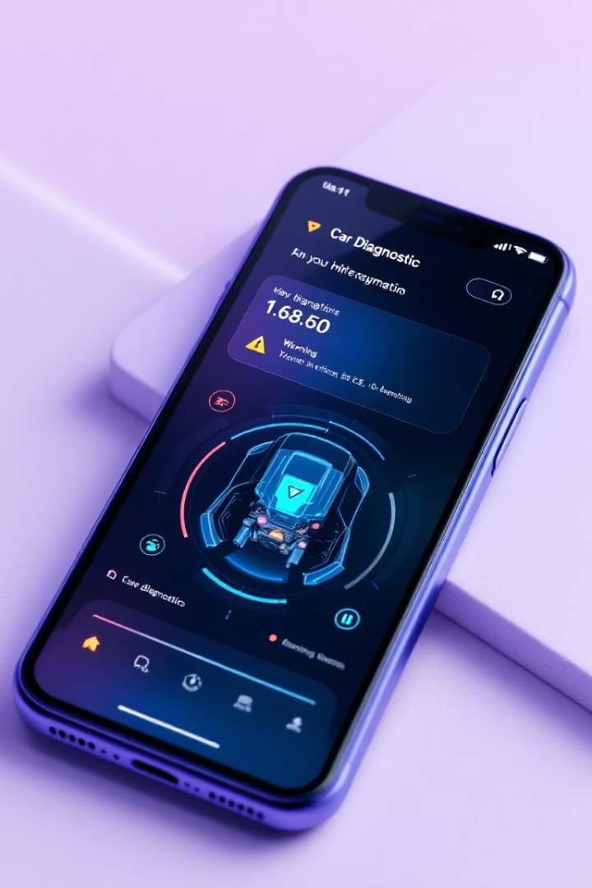


Car Fault Diagnosis Mobile Application
Our group has conducted extensive research to gather requirements for this innovative solution that aims to empower car owners with diagnostic capabilities.
This presentation will walk you through our stakeholder identification, requirement gathering techniques, data collection methods, and key insights that will shape our application design. Join us as we explore how this app will help drivers understand warning signs and potentially save them from costly repairs.
by Shalom Brenda
Group 18

Slide 2





Stakeholder Identification
Primary Stakeholders
Car Owners/Drivers: Primary users who need accurate, easy-to-understand diagnostics
Development Team
Mobile App Developers and UI/UX Designers responsible for implementation and user experience
Technical Experts
Automobile Mechanics/Technicians providing ground-truth knowledge for system validation
Academic Oversight
Project Supervisors/Academic Advisors ensuring methodology is sound and objectives are met

Slide 3






Requirement Gathering Techniques
Comprehensive Approach
Combined user-centric and expert-centric methods
Surveys & Interviews
Google Forms and in-person discussions
Brainstorming & Analysis
Team sessions and competitive research
Our group employed multiple techniques to ensure we captured requirements. We distributed surveys through social media groups targeting car owners and taxi drivers, conducted interviews with mechanics and lecturers, held brainstorming sessions to ideate features, and analyzed existing applications to identify gaps in the market.

Slide 4
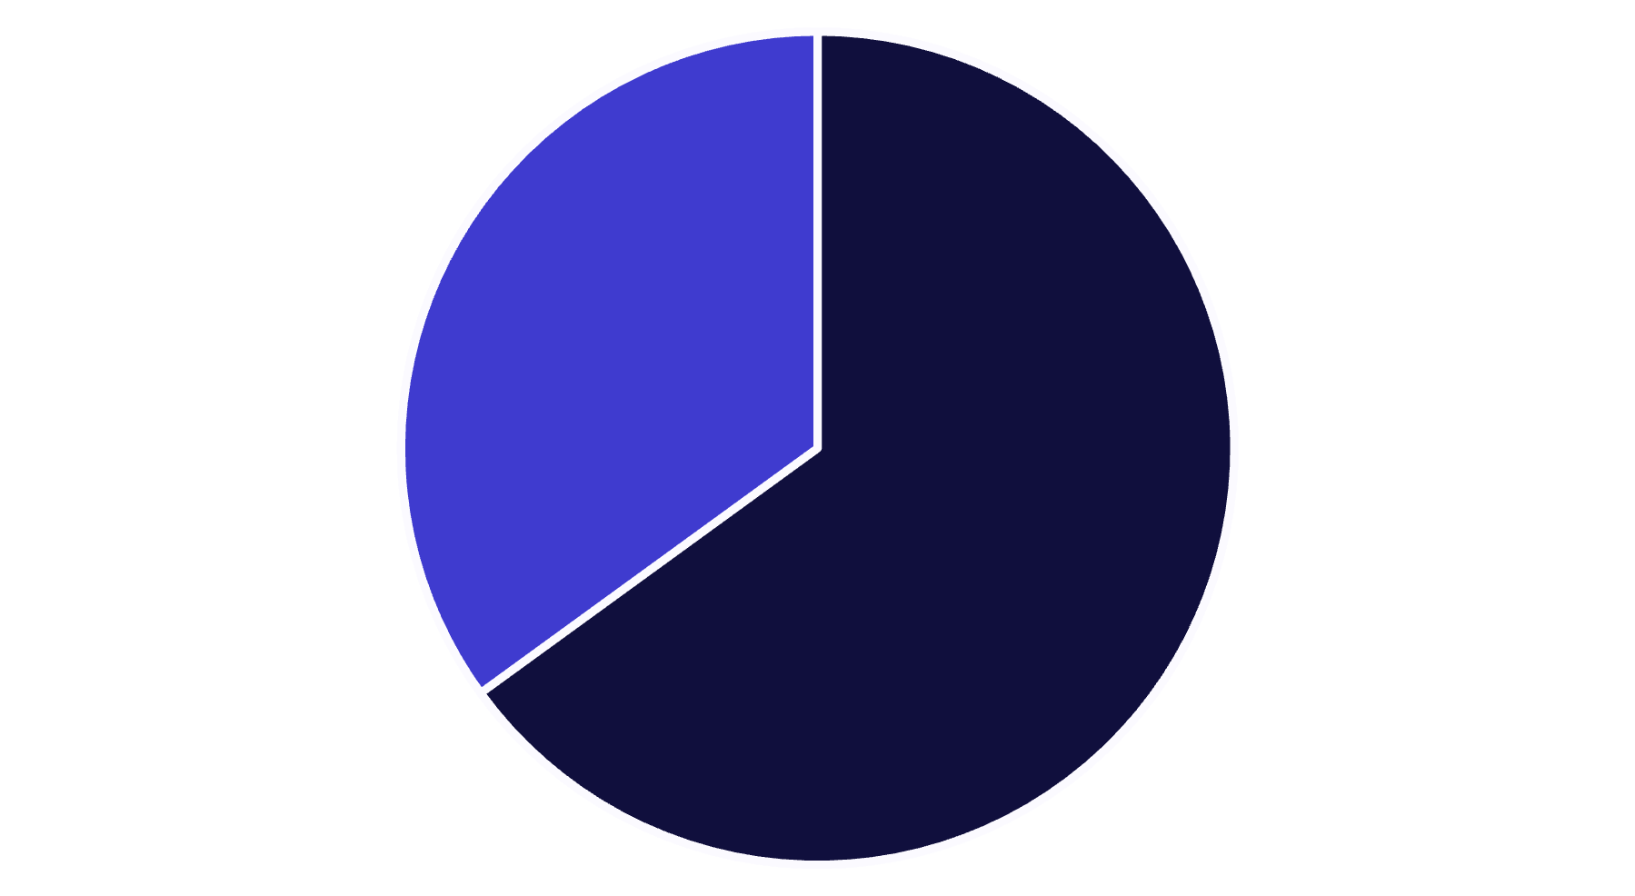
Survey Insights: Dashboard Warnings
When faced with dashboard warnings, drivers experienced outcomes ranging from immediate car breakdowns to engine seizures. Many simply didn't know what the lights signified and were forced to seek mechanic assistance, often at considerable expense. This highlights a critical knowledge gap that our application aims to address.
Don't understand warnings
Understand warnings
Our survey revealed that a significant majority of drivers (65%) don't understand dashboard warning lights when they appear. This lack of understanding leads to serious consequences, as reported by respondents

Slide 5
Survey Insights: Driver Behavior
Warning Light Response
Roadside Breakdowns
65% of respondents admitted to ignoring dashboard warning lights or strange noises from their vehicles. This behavior consistently led to negative outcomes:
The majority of survey participants reported experiencing breakdowns while driving. Their responses included:
Calling mechanics
Complete breakdowns
Seeking help from passersby
Engines failing to start
Abandoning vehicles
Costly repairs
Attempting basic troubleshooting

Slide 6

Survey Insights: Mechanic Relations
72.5%
65%
95%
Overcharged
Lack Confidence
App Interest
Percentage of drivers who believe they've been overcharged by mechanics due to lack of knowledge
Percentage of drivers who are not confident in their mechanics' advice
Percentage showing interest in using a smartphone-based diagnostic tool
These statistics highlight a significant trust gap between car owners and mechanics, as well as a strong market demand for our proposed solution. By empowering users with diagnostic capabilities, we can help them make more informed decisions about repairs and maintenance.

Slide 7
Interview Findings
Mechanics' Perspective
Academic Input
Car Owners' Wishes
From visits to 5 workshops (Moki, Mbako, BOCOM, Solo & Sons, Bius), mechanics emphasized that while expert diagnosis is best, apps could effectively triage issues and guide users on what requires urgent attention. They noted that customers often come with vague complaints, suggesting a feature to guide symptom reporting would be valuable.
Three lecturers (Dr. Nkemeni Valery, Dr. Marshall, Dr. Ines Djouela) suggested the app should generate revenue, minimize mechanic extortion, enable on-site fault detection, and educate users about their vehicles. Their academic perspective added valuable insights on sustainability and educational components.
Ten car owners expressed interest in OBD-II data diagnostics and maintenance history tracking. Their practical needs reinforced the importance of creating an accessible tool that provides actionable information and helps track vehicle health over time.

Slide 8
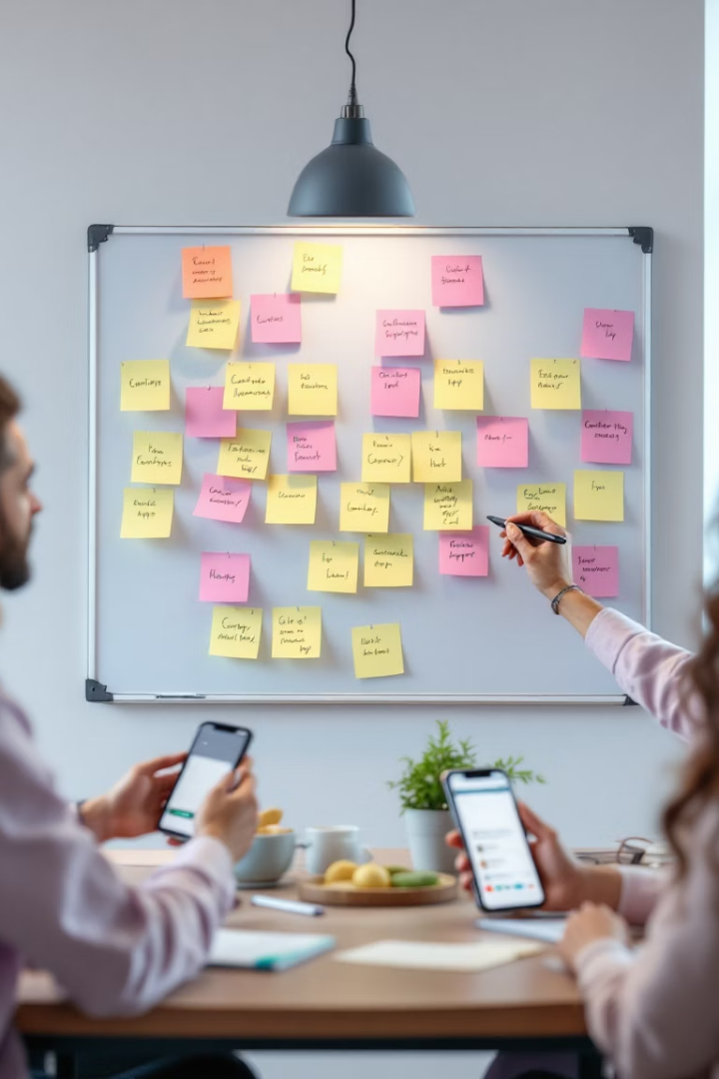
Brainstorming & Competitive Analysis
Ideation Sessions
Two group sessions categorized features into core (must-have), important (nice-to-have), and future (scalable) capabilities
Technical Architecture
Explored image detection, audio classification frameworks, and simplified UI with icons and one-click scanning
Competitive Analysis
Evaluated OBD2 Car Scanner, OBB Auto Doctor, and OBD Docker to identify gaps and opportunities
Revenue Models
Considered advertising and premium subscription options for sustainable development
Our competitive edge will include requiring only an affordable OBD-II Bluetooth adapter, providing AI-driven real-time feedback, and offering educational resources linked to each diagnosis. This approach addresses limitations in existing solutions that are often expensive and not intuitive for average users.

Slide 9








Data Collection & Challenges
Surveys
Interviews
Google Forms distributed to car owners
Discussions with experts and users
Validation
Observation
Manual review and expert verification
Real-world driver behavior monitoring
During our research, we encountered several challenges including user reluctance. Some potential participants were uncooperative, lacked confidence in their knowledge, or simply distrusted our research intentions. We mitigated these issues by providing clear information about our project goals and maintaining a patient, understanding approach during interactions.

Slide 10
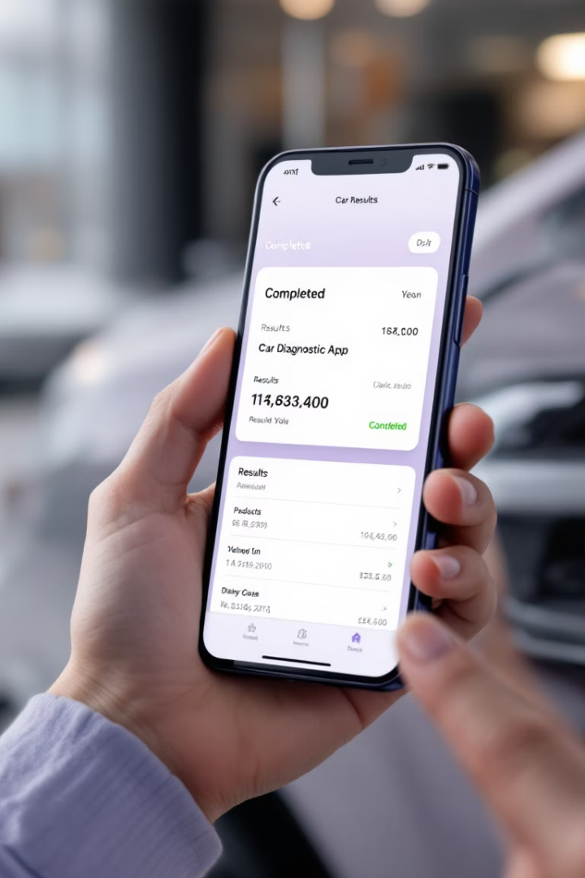




Conclusion & Next Steps
Clear User Need
Research confirms strong demand for mobile, AI-powered car diagnostic tool
Validated Data Foundation
Comprehensive insights from diverse sources ensure reliable development basis
System Design Phase
Moving forward with architecture planning and feature prioritization
Implementation
Beginning development with core features based on gathered requirements
Our requirement gathering process has established a solid foundation for developing an application that addresses real user needs. With a deep understanding of user pain points, technical feasibility, and market opportunities, we are well-positioned to move into the system design and implementation phases. The resulting application will help bridge the knowledge gap between car owners and mechanics, potentially saving users from costly repairs and roadside emergencies.

